Slide 1
Balanced Living

Slide 2
Focal Passage
Philippians 2:14–16 (NASB95) ¹⁴ Do all things without grumbling or disputing; ¹⁵ so that you will prove yourselves to be blameless and innocent, children of God above reproach in the midst of a crooked and perverse generation, among whom you appear as lights in the world, ¹⁶ holding fast the word of life, so that in the day of Christ I will have reason to glory because I did not run in vain nor toil in vain.

Slide 3
All Things
Philippians 2:12–13 (NASB95) ¹² So then, my beloved, just as you have always obeyed, not as in my presence only, but now much more in my absence, [you] work out your salvation with fear and trembling; ¹³ for it is God who is at work in you, both to will and to work for His good pleasure.

Slide 4
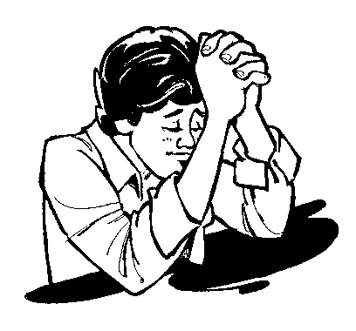
Outward evidence of God working in you
Holy Spirit
God works in you
Philippians 2:12-13

Slide 5
All Things
Philippians 4:4 Rejoice in the Lord always; again I will say, rejoice!

Slide 6
First Reason
FOR YOUR SAKE
Blameless – without defect
Innocent – pure
Above Reproach – no criticism

Slide 7
Children of God
Faith
Galatians 3:26 For you are all sons of God through faith in Christ Jesus.

Slide 8
Children of God
Adoption
Romans 8:15 For you have not received a spirit of slavery leading to fear again, but you have received a spirit of adoption as sons by which we cry out, “Abba! Father!”

Slide 9
Children of God
Birth
1 Peter 1:23 for you have been born again not of seed which is perishable but imperishable, that is, through the living and enduring word of God.

Slide 10
First Reason
Blameless
Luke 1:6 They were both righteous in the sight of God, walking blamelessly in all the commandments and requirements of the Lord.

Slide 11
First Reason
Blameless
1 Thessalonians 3:13 so that He may establish your hearts without blame in holiness before our God and Father at the coming of our Lord Jesus with all His saints.

Slide 12
First Reason
Innocent
Romans 16:19 For the report of your obedience has reached to all; therefore I am rejoicing over you, but I want you to be wise in what is good and innocent in what is evil.

Slide 13
First Reason
Above Reproach
Jude 24 Now to Him who is able to keep you from stumbling, and to make you stand in the presence of His glory blameless with great joy,

Slide 14
Second Reason
FOR THE SAKE OF THE UNSAVED
Crooked – bent, curved, twisted
Perverse – morally corrupt

Slide 15
Second Reason
Philippians 2:14–16 ¹⁴ Do all things without grumbling or disputing; ¹⁵ so that you will prove yourselves to be blameless and innocent, children of God above reproach in the midst of a crooked and perverse generation, among whom you appear as lights in the world, ¹⁶ holding fast the word of life, so that in the day of Christ I will have reason to glory because I did not run in vain nor toil in vain.

Slide 16
Second Reason
Crooked
Deuteronomy 32:5 “They have acted corruptly toward Him, They are not His children, because of their defect; But are a perverse and crooked generation.

Slide 17
Second Reason
Perverse
Luke 23:2 And they began to accuse Him, saying, “We found this man misleading [perverting] our nation and forbidding to pay taxes to Caesar, and saying that He Himself is Christ, a King.”
Acts 20:30 and from among your own selves men will arise, speaking perverse things, to draw away the disciples after them.

Slide 18
Second Reason
Lights in the world
Daniel 12:3 “Those who have insight will shine brightly like the brightness of the expanse of heaven, and those who lead the many to righteousness, like the stars forever and ever.

Slide 19
Third Reason
FOR THE SAKE OF CHURCH LEADERS
Day of Christ – reason to glory

Slide 20
Third Reason
Day of Christ
2 Corinthians 5:10 For we must all appear before the judgment seat of Christ, so that each one may be recompensed for his deeds in the body, according to what he has done, whether good or bad.

Slide 21
Conclusion
Harmful to you
Turns unbelievers away
Disheartens church leaders
Dishonors God

